Slide 1


Slide 2



DRIVER CONNECTIONS
IN
JAVA

Slide 3

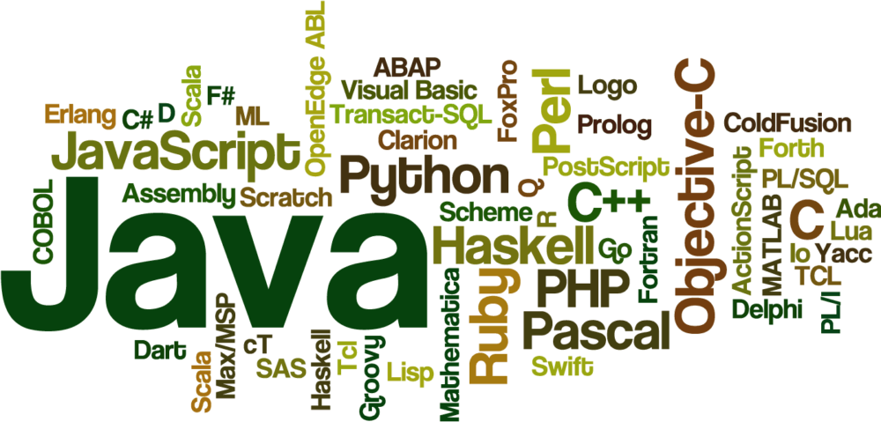


Slide 4
DRIVER MANAGER CLASS
The Driver Manager class acts as an interface between user and drivers.
It keeps track of the drivers that are available and handles establishing a connection between a database and the appropriate driver.
The DriverManager class maintains a list of Driver classes that have registered themselves by calling the method DriverManager.registerDriver().

Slide 5
METHODS IN DRIVER MANAGER

Slide 6
getConnection
public static Connection getConnection(String url, String user, String password) throws SQLException
Parameters:
url - a database url of the form jdbc:subprotocol:subname
user - the database user on whose behalf the connection is being made
password - the user's password
Returns:
a connection to the URL
Notes:
Throws:SQLException - if a database access error occurs or the url is null
SQLTimeoutException - when the driver has determined that the timeout value specified by the setLoginTimeout method has been exceeded and has at least tried to cancel the current database connection attempt

Slide 7
getDriver
public static Driver getDriver(String url) throws SQLException
Parameters:
url - a database URL of the form jdbc:subprotocol:subname
Returns:
a Driver object representing a driver that can connect to the given URL
Throws:
SQLException - if a database access error occurs
Notes:
Attempts to locate a driver that understands the given URL. The DriverManager attempts to select an appropriate driver from the set of registered JDBC drivers.

Slide 8
deregisterDriver
public static void deregisterDriver(Driver driver) throws SQLException
Removes the specified driver from the DriverManager's list of registered drivers.
If a null value is specified for the driver to be removed, then no action is taken.
If a security manager exists and its checkPermission denies permission, then a SecurityException will be thrown.

Slide 9
deregisterDriver
If the specified driver is not found in the list of registered drivers, then no action is taken. If the driver was found, it will be removed from the list of registered drivers.
If a DriverAction instance was specified when the JDBC driver was registered, its deregister method will be called prior to the driver being removed from the list of registered drivers.

Slide 10
Parameters
parameters:
driver - the JDBC Driver to remove
Throws:
SQLException - if a database access error occurs
SecurityException - if a security manager exists and its checkPermission method denies permission to deregister a driver.

Slide 11
Connection interface
A Connection is the session between java application and database.
The Connection interface is a factory of Statement, Prepared Statement, and Database Metadata i.e. object of Connection can be used to get the object of Statement and Database Metadata.
The Connection interface provide many methods for transaction management like commit(), rollback() e

Slide 12
METHODS IN CONNECTION INTERFACE

Slide 13
createStatement
public Statement createStatement()
Returns:
a new default Statement object
Throws:
SQLException - if a database access error occurs or this method is called on a closed connection
Notes:
Creates a Statement object for sending SQL statements to the database. SQL statements without parameters are normally executed using Statement objects. If the same SQL statement is executed many times, it may be more efficient to use a PreparedStatement object.

Slide 14
setAutoCommit
void setAutoCommit(boolean autoCommit) throws SQLException
Parameters:
autoCommit - true to enable auto-commit mode; false to disable it
Throws:
SQLException - if a database access error occurs, setAutoCommit(true) is called while participating in a distributed transaction, or this method is called on a closed connection
Notes:
Sets this connection's auto-commit mode to the given state. If a connection is in auto-commit mode, then all its SQL statements will be executed and committed as individual transactions. Otherwise, its SQL statements are grouped into transactions that are terminated by a call to either the method commit or the method rollback. By default, new connections are in auto-commit mode.The commit occurs when the statement completes. The time when the statement completes depends on the type of SQL Statement:
For DML statements, such as Insert, Update or Delete, and DDL statements, the statement is complete as soon as it has finished executing.
For Select statements, the statement is complete when the associated result set is closed.
For CallableStatement objects or for statements that return multiple results, the statement is complete when all of the associated result sets have been closed, and all update counts and output parameters have been retrieved.
NOTE: If this method is called during a transaction and the auto-commit mode is changed, the transaction is committed. If setAutoCommit is called and the auto-commit mode is not changed, the call is a no-op.

Slide 15
getDriver
public static Driver getDriver(String url) throws SQLException
Parameters:
url - a database URL of the form jdbc:subprotocol:subname
Returns:
a Driver object representing a driver that can connect to the given URL
Throws:
SQLException - if a database access error occur
Notes:
Attempts to locate a driver that understands the given URL. The DriverManager attempts to select an appropriate driver from the set of registered JDBC drive

Slide 16
RESULT SET
A table of data representing a database result set, which is usually generated by executing a statement that queries the database.
A ResultSet object maintains a cursor pointing to its current row of data. Initially the cursor is positioned before the first row.
The next method moves the cursor to the next row, and because it returns false when there are no more rows in the ResultSet object, it can be used in a while loop to iterate through the result set.
Notes:
Attempts to locate a driver that understands the given URL. The DriverManager attempts to select an appropriate driver from the set of registered JDBC drive

Slide 17
The object of ResultSet maintains a cursor pointing to a row of a table. Initially, cursor points to before the first row.
But we can make this object to move forward and backward direction by passing either TYPE_SCROLL_INSENSITIVE or TYPE_SCROLL_SENSITIVE in createStatement(int,int) method as well as we can make this object as updatable by:
Statement stmt = con.createStatement(ResultSet.TYPE_SCROLL_INSENSITIVE, ResultSet.CONCUR_UPDATABLE);
Notes:
Attempts to locate a driver that understands the given URL. The DriverManager attempts to select an appropriate driver from the set of registered JDBC drive

Slide 18
METHODS IN RESULT SET:
public boolean next() | is used to move the cursor to the one row next from the current position
public boolean previous(): | is used to move the cursor to the one row previous from the current position.
public boolean first(): | is used to move the cursor to the first row in result set object.
public boolean last(): | is used to move the cursor to the last row in result set object.
public int getInt(int columnIndex): | is used to return the data of specified column index of the current row as int.
Notes:
Attempts to locate a driver that understands the given URL. The DriverManager attempts to select an appropriate driver from the set of registered JDBC drive

Slide 19
EXAMPLE:
import java.sql.*; class FetchRecord{ public static void main(String args[])throws Exception{ Class.forName("oracle.jdbc.driver.OracleDriver"); Connection con=DriverManager.getConnection("jdbc:oracle:thin:@localhost:1521:xe","system","oracle"); Statement stmt=con.createStatement(ResultSet.TYPE_SCROLL_SENSITIVE,ResultSet.CONCUR_UPDATABLE); ResultSet rs=stmt.executeQuery("select * from emp765"); //getting the record of 3rd row rs.absolute(3); System.out.println(rs.getString(1)+" "+rs.getString(2)+" "+rs.getString(3)); con.close(); }}
Notes:
Attempts to locate a driver that understands the given URL. The DriverManager attempts to select an appropriate driver from the set of registered JDBC drive

Slide 20

THANK YOU

